Slide 1


Unlocking Potential: Transforming Data Strategies for a Bold Future at Social Buzz
Unlocking Potential: Enhancing Data Strategies for Social Buzz's Future

Slide 2


Today's agenda
Project recap
Problem
The Analytics team
Process
Insights
Summary

Slide 3

Social Buzz was founded by two former engineers from a major social media company. The platform allows users to interact anonymously with content, offering over 100 different reactions for various media types. With more than 500 million active users each month and over 100,000 pieces of content posted daily, Social Buzz has experienced rapid growth and now faces significant challenges in managing its data.
Project Recap

Slide 4

Problem
Preparation for IPO: Social Buzz aims to complete an initial public offering (IPO) by the end of next year and needs guidance to ensure a smooth process.
2.Resource Management: As a small company, they lack the internal resources to manage their current scale effectively and prefer to learn from experienced firms rather than hiring more staff.
3. Learning Best Practices: They want to understand how larger corporations handle big data challenges.

Slide 5



Andrew Fleming Chief Technical Architect
The Analytics team
Marcus Rompton
Senior Principle
Kashish Agrawal
Data Analyst

Slide 6
Process
1
Data Understanding
2
Data Cleaning
3
Data Modelling
4
Data Analysis
5
Uncover Insights

Slide 7

Insights
Reactions To ‘Animal’ Posts
Month With Most Posts
Unique Categories
16
1897
January

Slide 8
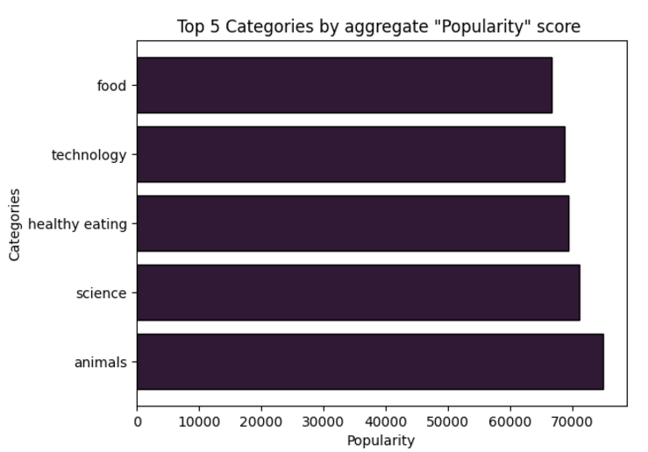

Slide 9
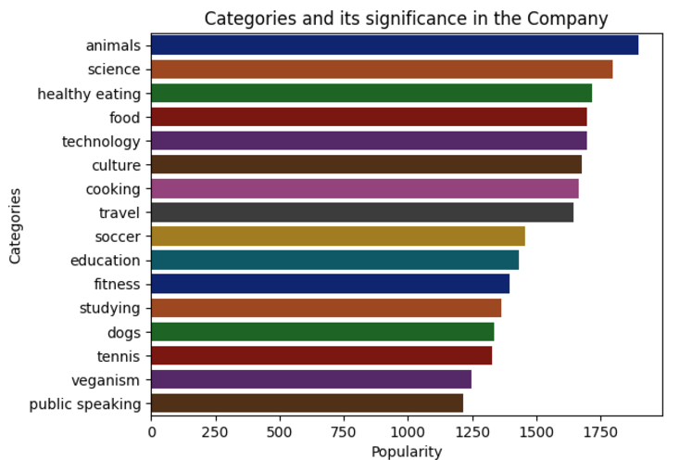

Slide 10
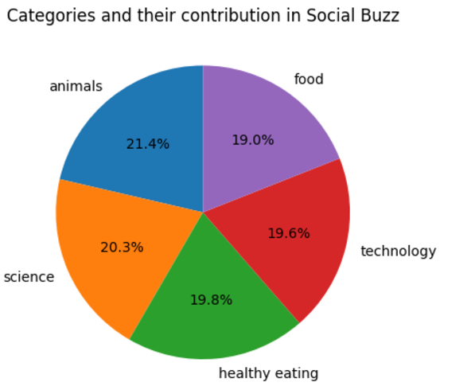

Slide 11

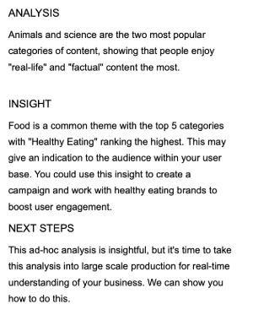
Summary

Slide 12
Thank you!

